Slide 1
Introduction to Relational Algebra
Examples and Exercises

Slide 2
What is Relational Algebra?
A procedural query language for relational databases.
It uses a set of operations to manipulate and retrieve data stored in a relational database.
Forms the theoretical foundation for SQL queries.

Slide 3
Types of Relational Algebra
Basic Operations: Selection (σ), Projection (π), Union (⋃), Set Difference (−), Cartesian Product (×), Rename (ρ).2.
Advanced Operations: Intersection (∩), Natural Join (⋈), Theta Join (⋈θ), Division (÷).

Slide 4
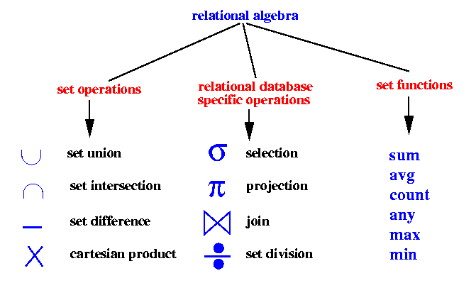
Operation Operators

Slide 5
Selection Operator
Definition: Selects rows from a relation that satisfy a given predicate.
Syntax: σ condition (Table Name)
Example:
Filters rows based on a condition, returning only those that meet the criteria.

Slide 6
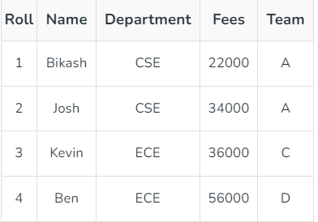

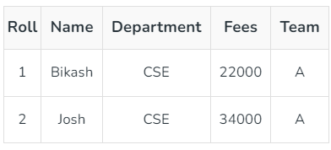
Example of Selection

Slide 7
Projection Operator
Definition: Selects specific columns from a relation.
Syntax: π attribute_list (Table Name)
Removes duplicate rows automatically.

Slide 8

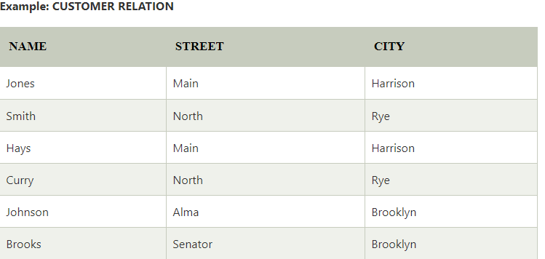
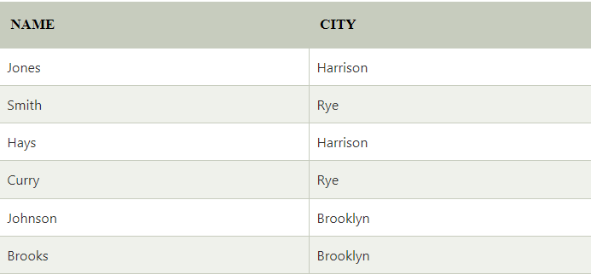
Example of Projection

Slide 9
Union Operator
Definition: Combines tuples from two relations, removing duplicates.
Syntax: R ⋃ S
Both relations must have the same attributes.

Slide 10
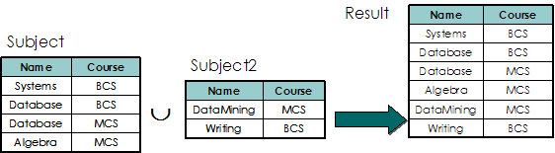
Example of Union Operator
Subject U Subject2

Slide 11
Intersection Operator
Definition: Returns tuples present in both relations.
Syntax: R ∩ S

Slide 12
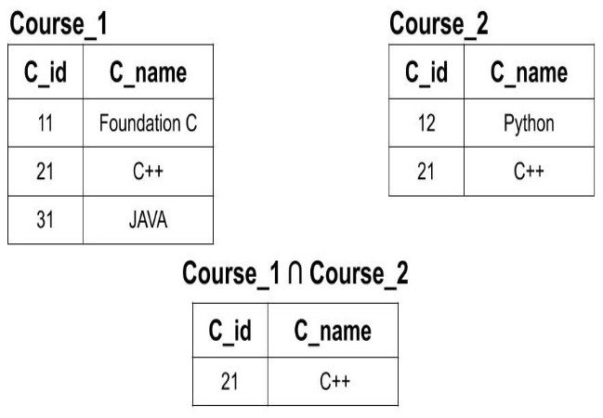
Example of Intersection

Slide 13
Natural Join Operator
Definition: Combines tables based on common attributes.
Syntax: R ⋈ S
Automatically matches rows with the same values in the common attributes.

Slide 14
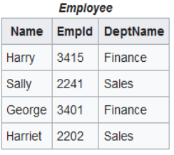
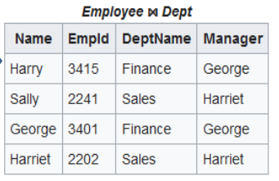
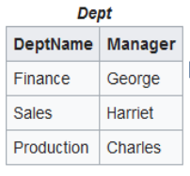
Example of Natural Join

Slide 15
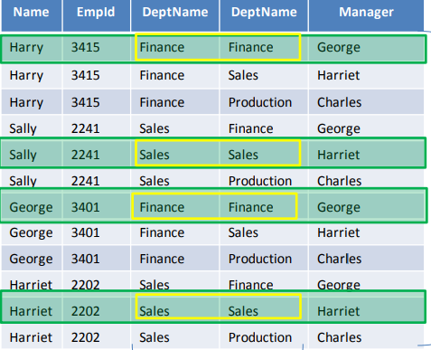
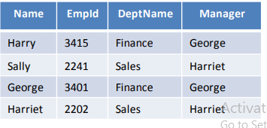
How works Natural Join

Slide 16

Left Outer Join
Suppose there are two relations( 2 tables) R and S
All the tuples(rows) from the Left relation(table) R are included in the resulting relation
If there are tuples(rows) in R without any matching tuple in the Right relation S, then the S-attributes of the resulting relation are made NULL.
Syntax: S R

Slide 17
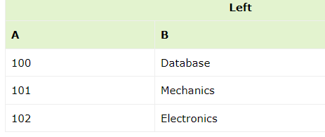
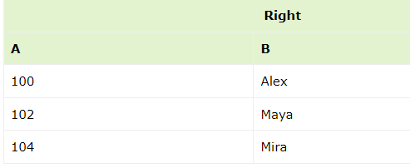
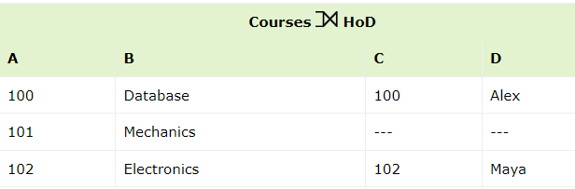
Example of Left Outer Join

Slide 18

Right Outer Join
Suppose there are two relations( 2 tables) R and S
All the tuples(rows) from the Right relation S are included in the resulting relation
If there are tuples in S without any matching tuple in R, then the R-attributes of resulting relation are made NULL.
Syntax: R S

Slide 19
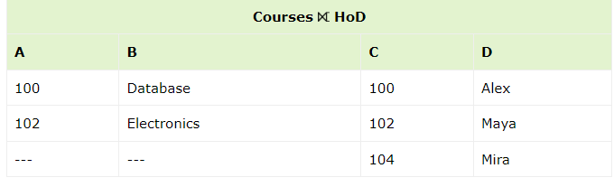
Example of Right Outer Join

Slide 20

Full Outer Join
Suppose there are two relations( 2 tables) R and S.
All the tuples from both participating relations are included in the resulting relation
If there are no matching tuples for both relations, their respective unmatched attributes are made NULL.
Syntax: R S

Slide 21
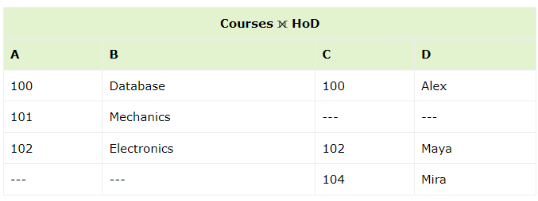
Example of Full Outer Join

Slide 22
Set Functions Or Aggregation Functions
COUNT
SUM
AVG
MAX
MIN

Slide 23
Count Function
COUNT function is used to Count the number of rows in a database table. It can work on both numeric and non-numeric data types.
COUNT function uses the COUNT(*) that returns the count of all the rows in a specified table. COUNT(*) considers duplicate and Null.

Slide 24
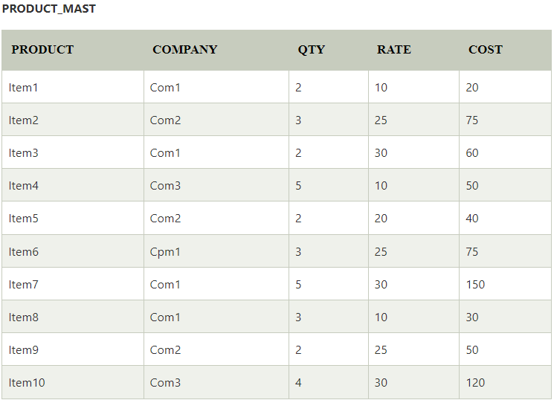

Example of COUNT Function
10

Slide 25
SUM Function
Sum function is used to calculate the sum of all selected columns. It works on numeric fields only.

Slide 26

Example of SUM
670

Slide 27

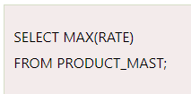

AVG, MAX & MIN
67.00
Table: slide no-16
PRODUCT_MAST
30
10

